Slide 1

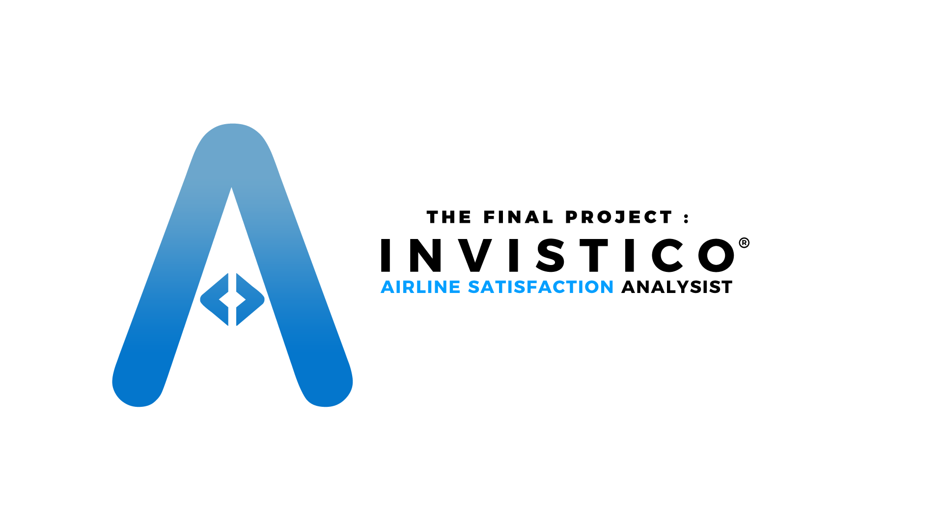
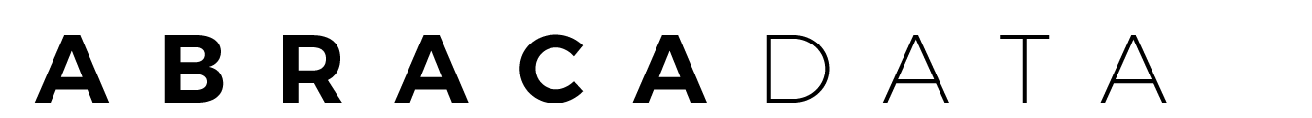
June 11th 2021
Presented by

Slide 2
About Us!
Abracadata was founded in 2021 as a data science consultant that aims to provide the best business recommendations for your company. Our members consist of five, namely:
Erick Rafly Keliat
Kukuh Utama Putra
Lukman Nurhakim
Rahmat Arif Ramadhan
Zildjian Rachman
We thank all parties who have helped a lot in the process of completing this project, especially Mr. Hafizh who has given many inputs and suggestions during the work on this project.

Slide 3
Table Of Contents
Abracadata
Problem &
Data
The Process
Target
Provide an understanding of the existing problems and data gathering.
The problem solving process from data exploration to model evaluation tests.
Business recommendations for existing problems.

Slide 4




Problem Statement
Invistico Airline asked Abracadata as business consultant to provide them with business recommendations to increase their customer satisfaction level without reducing revenue.
Abracadata
We focus on finding what services need to be improved so that invistico customer satisfaction increases.
We are looking for the best way to improve the quality of service so that the number of satisfied customers increases.
With the increase of satisfied customers, it will increase the level of customer satisfaction without reducing revenue.

Slide 5

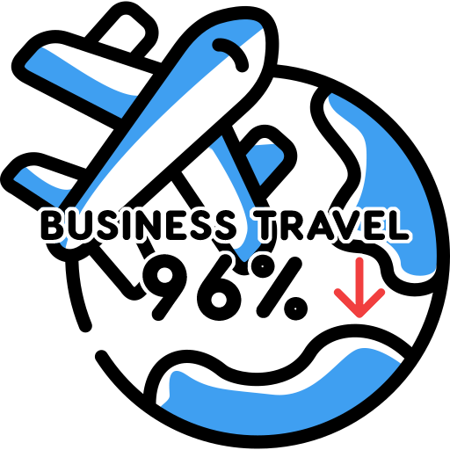

Issues
Abracadata
Considering the current condition where the effects of the Covid-19 pandemic have made business travel decline, according to the data, there was a 96% decline, therefore we decided to focus on personal travel because the data is more dominant.
*Data taken from : Investopedia.com

Slide 6
The Process
Abracadata
Dataset from Invistico Airlines
17610.0
15395.0
We focused on Eco & Eco Plus customer
because Business class have minimum data compared to Eco class.
1431.0
1242.0
2415.0
2094.0
Business
Eco
Eco Plus
Percentage satisfaction in feature class.
53.5
53.4
53.6
46.5
46.6
46.4
Business
Eco
Eco Plus

Slide 7
ECO Class Optimalization
Abracadata
The percentage of Eco Plus class trips is the lowest when compared to other classes, as well as the satisfaction level which is still below the Business and Eco class, therefore we combine Eco and Eco Plus into one value in class features called Eco.
53.6
Get service that will increase customer satisfaction.
46.4
MODELLING
Eco
Satisfaction rate of Eco Class

Slide 8
To determine the right model, we have done pre-modelling based on five models namely Logistic Regression, Decision Tree, XGBoost, AdaBoost and Random Forest. From this model, we choose to use logistic regression because it is simple and easy to use for business.
Model
Accuracy
Precision
Random Forest
0.99
0.93
Logistic Regression
0.86
0.83
XGBoost
0.93
0.94
AdaBoost
0.9
0.89
What is Accuracy and Precision?
Decision Tree
0.91
0.91
.
HyperParameter Tuning
Accuracy
is a metric used to correctly assess a prediction of satisfied or dissatisfied customers
.
Model
Accuracy
Precision
Precision
is a metric used to correctly assess a prediction of satisfied customers based on the total predictions of satisfied customers
Random Forest
0.93
0.94
Logistic Regression
0.85
0.84
XGBoost
0.93
0.94
AdaBoost
0.9
0.89
Decision Tree
0.89
0.89

Slide 9
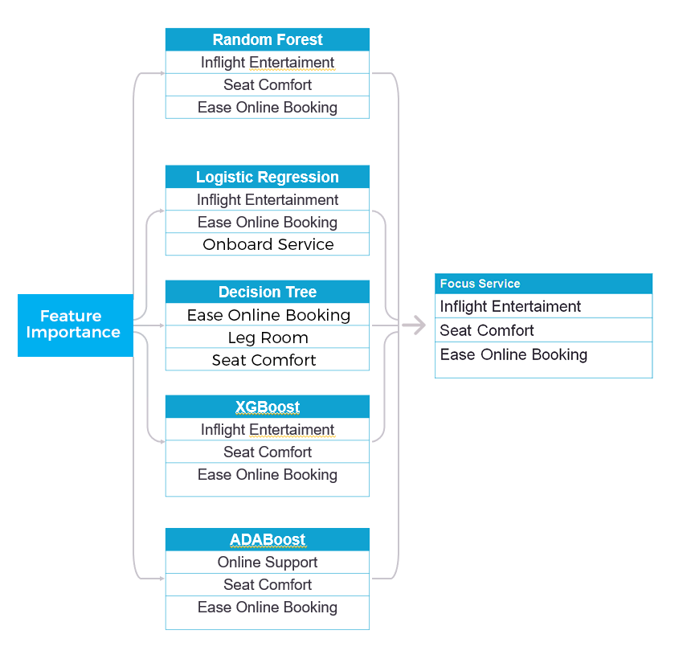
Feature Importance
Abracadata
After the modeling process, we determine the important features that we will use as a reference for business recommendations. We also display various kinds of feature importance with different types of models.

Slide 10
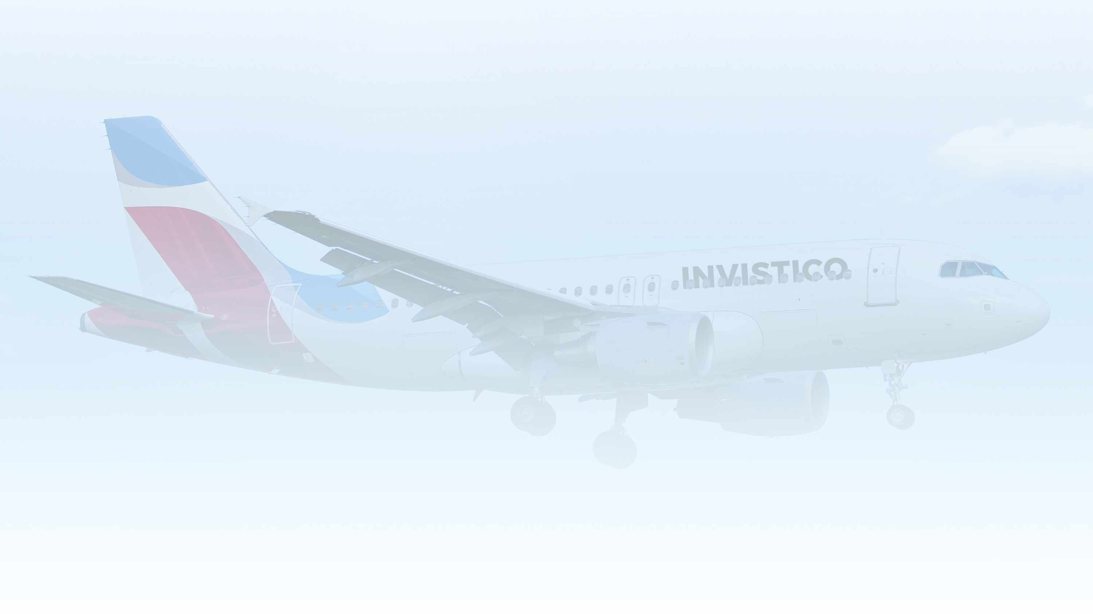
The Target
Abracadata
“We provide business recommendations for Inflight Entertainment, Online Service and Seat Comfort as variables that need to be improved by Invistico to increase customer satisfaction without reducing revenue”

Slide 11

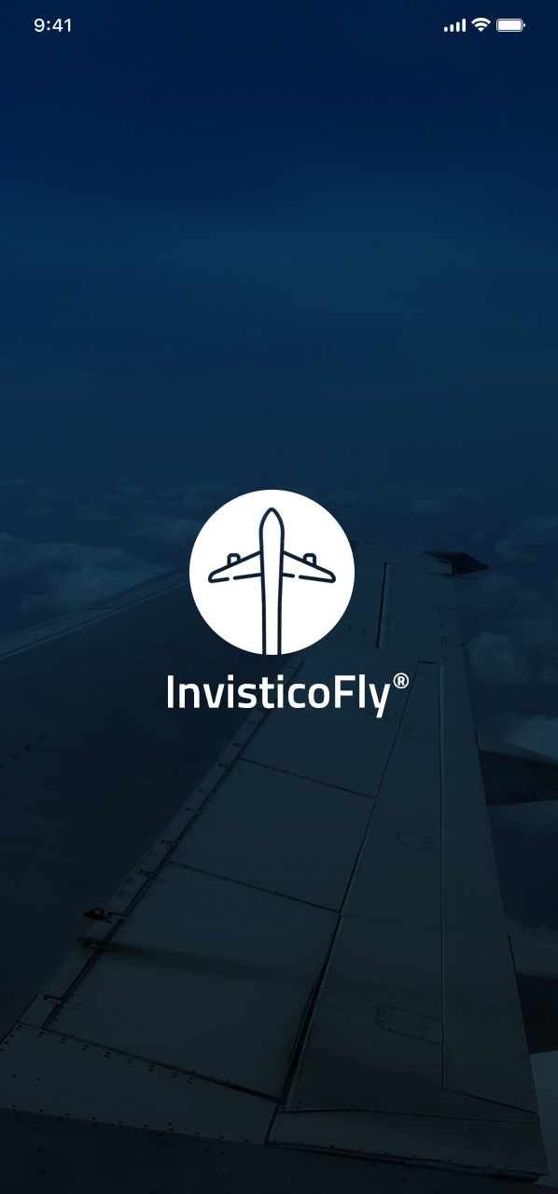
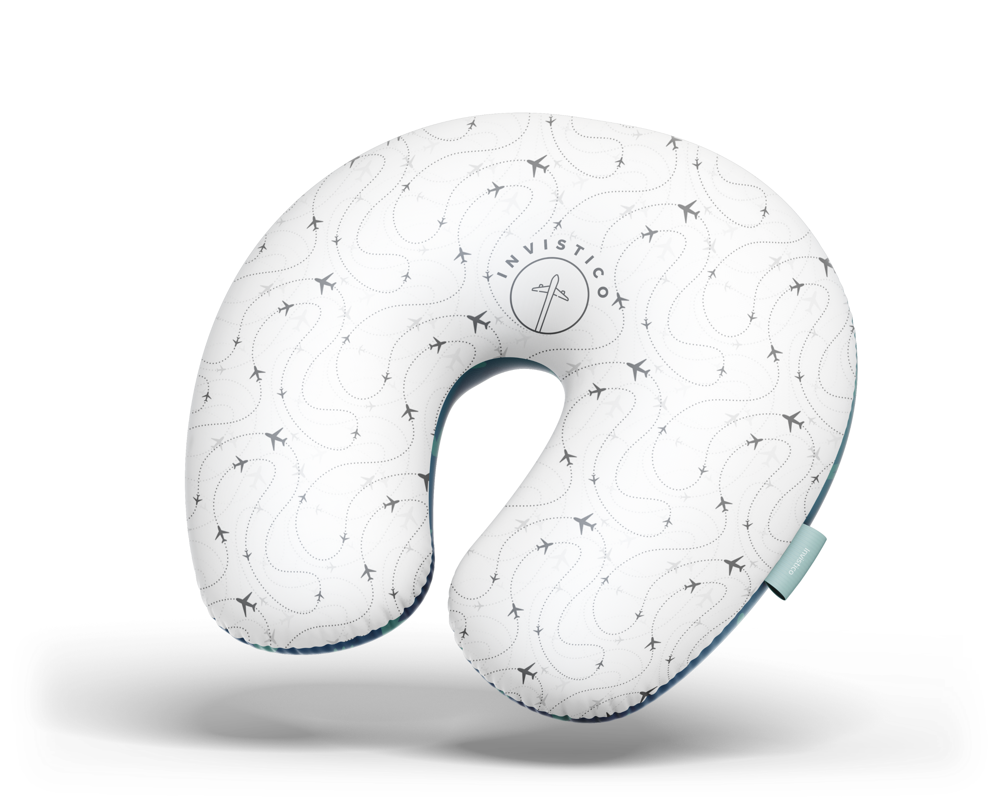
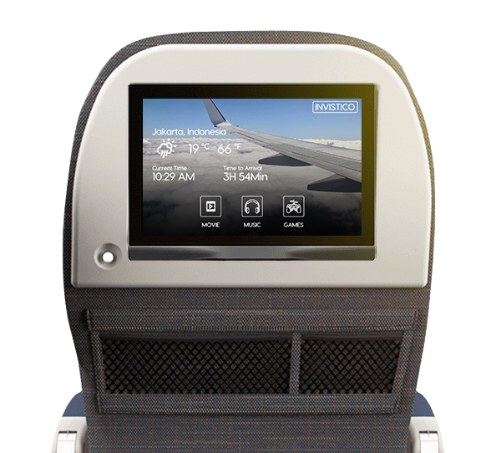
The Target
Abracadata
Online Service
Inflight Entertainment
Seat Comfort
Live TV and TV on demand
Movie
Games
Inflight Magazine
Book from anywhere
Easy2Pay
Cozy at all cost

Slide 12
Impact on Satisfaction
 | Condition |  |  | Satisfaction
01 | Current Eco Class Satisfied |  | 46,4%
02 | Impact on Eco Class Satisfied |  | 71,8%
03 | Impact on Invistico Customer Satisfaction |  | 80,8%

Slide 13
Impact on Revenue & Profit
Customer Lifetime Value
Average Ticket Price | Rp. 1.750.000,-
Average Customer Flying Year | 3X
Customer Retention | 6,09%
Gross Profit Margin | 16,11%
seat occupancy | 74%
Customer Lifetime Value | 39.089,39
Number of customers | 8.585.906
Economy Class Income | Rp.45.076.006.500.000
2,30% Profit | Rp. 1.036.748.149.500
Rp. 2.073.496.299.000
Profit in 2 Years
Return On Investment (ROI)
In 2 years
Investation
Inflight Entertainment | Rp.1.913.130.000.000,-
Seat Comfort | Rp.6.658.577.451,-
Onlinve Service | Rp.1.740.000.000,-
TOTAL | Rp.1.921.528.577.451,-

Slide 14
Conclusion
Based on the explanation that we have done, we can conclude that by applying the business recommendations that we have conveyed, it is proven that Invistico airline can increase their level of satisfaction without reducing revenue. Based on ROI, in the next 2 years the investment issued by Invistico can be paid off

